Slide 1
Web Architecture

Slide 2
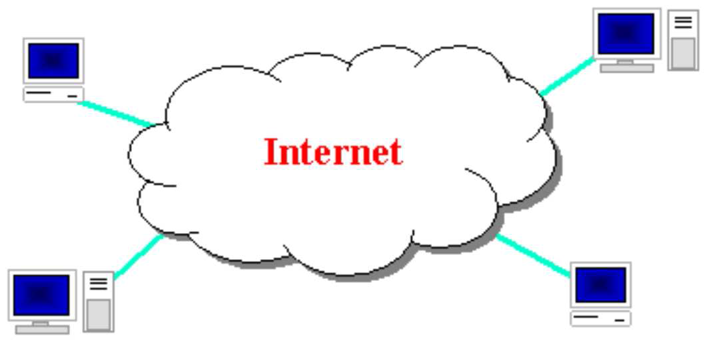
The Internet

Slide 3

The Internet
a connection of computer networks using the Internet Protocol (IP)
What's the difference between the Internet and the World Wide Web (WWW)?
The Web is the collection of web sites and pages around the world; the Internet is larger and also includes other services such as email, chat, online games, etc.

Slide 4
Brief history
began as a US Department of Defense network called ARPANET (1960s-70s)
initial services: electronic mail, file transfer
opened to commercial interests in late 80s
WWW created in 1989-91 by Tim Berners-Lee
popular web browsers released: Netscape 1994, IE 1995
Amazon.com opens in 1995; Google January 1996

Slide 5
Key aspects of the internet
Sub networks can stand on their own
computers can dynamically join and leave the network
built on open standards; anyone can create a new internet device
lack of centralized control (mostly)
everyone can use it with simple, commonly available software

Slide 6
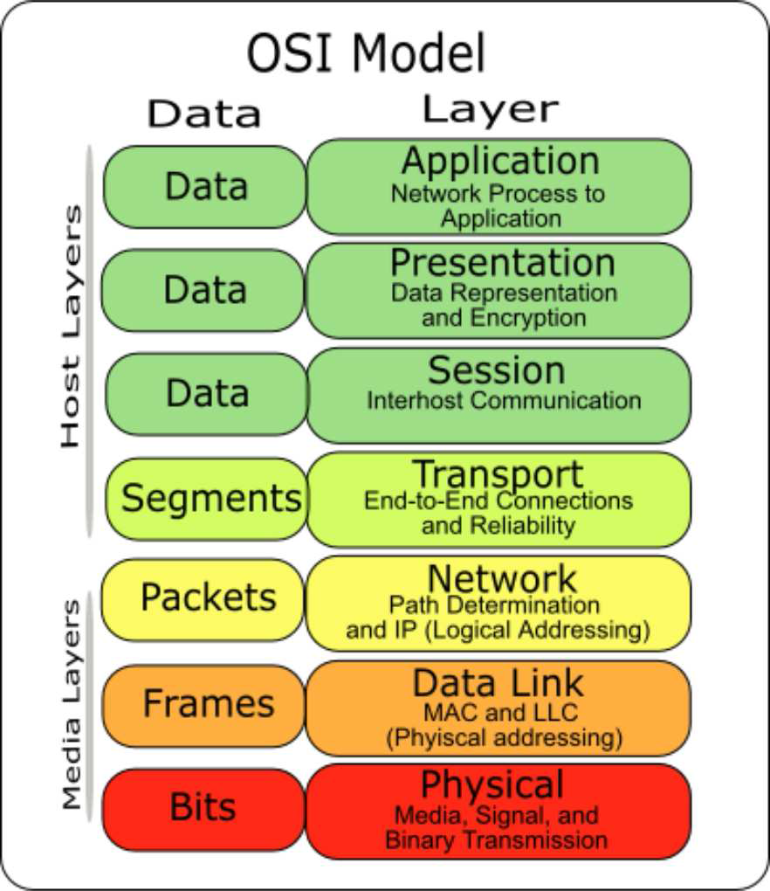
OSI Model

Slide 7
Layered architecture
The internet uses a layered hardware/ software architecture (also called the "OSI model"):
physical layer : devices such as ethernet, coaxial cables, fiber-optic lines, modems
data link layer : basic hardware protocols (ethernet, wifi,DSL)

Slide 8
Layered architecture
network / internet layer : basic software protocol (IP)
transport layer : adds reliability to network layer (TCP, UDP)
application layer : implements specific communication for each kind of program (HTTP, SSH, FTP)

Slide 9
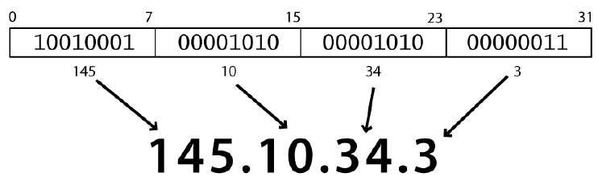
Internet Protocol (IP)
a simple protocol for attempting to send data between two computers
each device has a 32-bit IP address written as four 8-bit numbers (0-255)

Slide 10
Transmission Control Protocol (TCP)
adds multiplexing, guaranteed message delivery on top of IP
multiplexing: multiple programs using the same IP address
port: a number given to each program or service
port 80: web browser (port 443 for secure browsing)
port 25: email
port 22: ssh
port 5190: AOL Instant Messenger

Slide 11
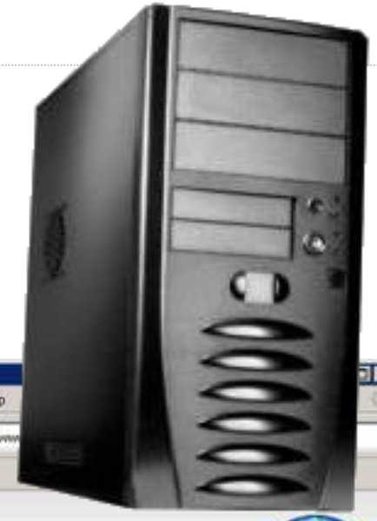
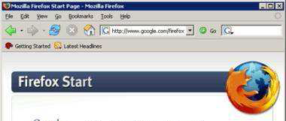
The World Wide Web (WWW)

Slide 12
Web servers and browsers
web server: software that listens for web page requests
Apache
Microsoft Internet Information Server (IIS) (part of Windows)

Slide 13
Web servers and browsers
web browser: fetches/displays documents from web servers
Mozilla Firefox
Microsoft Internet Explorer (IE)
Apple Safari
Google Chrome
Opera

Slide 14
Domain Name System (DNS)
a set of servers that map written names to IP addresses
Example: www.quest.edu.pk → 172.16.179.1

Slide 15
Uniform Resource Locator (URL)
an identifier for the location of a document on a web site
a basic URL:
http://www.aw-bc.com/info/regesstepp/index.html
Protocol host path

Slide 16
Uniform Resource Locator (URL)
upon entering this URL into the browser, it would:
ask the DNS server for the IP address of www.aw-bc.com
connect to that IP address at port 80
ask the server to GET /info/regesstepp/index.html
display the resulting page on the screen

Slide 17
More about URLs
anchor: jumps to a given section of a web page
http://www.textpad.com/download/index.html#downloads
fetches index.html then jumps down to part of the page labeled downloads

Slide 18
More about URLs
port: for web servers on ports other than the default 80
http://www.cs.washington.edu:8080/secret/money.txt

Slide 19
More about URLs
query string: a set of parameters passed to a web program
http://www.google.com/search?q=miserable+failure&start=10
parameter q is set to "miserable+failure“
parameter start is set to 10

Slide 20
Hypertext Transport Protocol (HTTP)
the set of commands understood by a web server and sent from a browser
some HTTP commands (your browser sends these internally):
GET filename : download
POST filename : send a web form response
PUT filename : upload

Slide 21
HTTP error codes
when something goes wrong, the web server returns a special "error code" number to the browser, possibly followed by an HTML document
common error codes:
Number Meaning
200 OK
301-303 page has moved (permanently or temporarily)
403 you are forbidden to access this page
404 page not found
500 internal server error

Slide 22
Internet media ("MIME") types
sometimes when including resources in a page (style sheet, icon, multimedia object), we specify their type of data
MIME type file extension
text/html .html
text/plain .txt
image/gif .gif
image/jpeg .jpg
video/quicktime .mov
application/octet-stream .exe

Slide 23
Web languages / technologies
Hypertext Markup Language (HTML):
used for writing web pages
Cascading Style Sheets (CSS):
stylistic info for web pages
PHP Hypertext Processor (PHP):
dynamically create pages on a web server
JavaScript:
interactive and programmable web pages
eXtensible Markup Language (XML):
Meta language for organizing data
Structured Query Language (SQL):
interaction with databases

